Slide 1
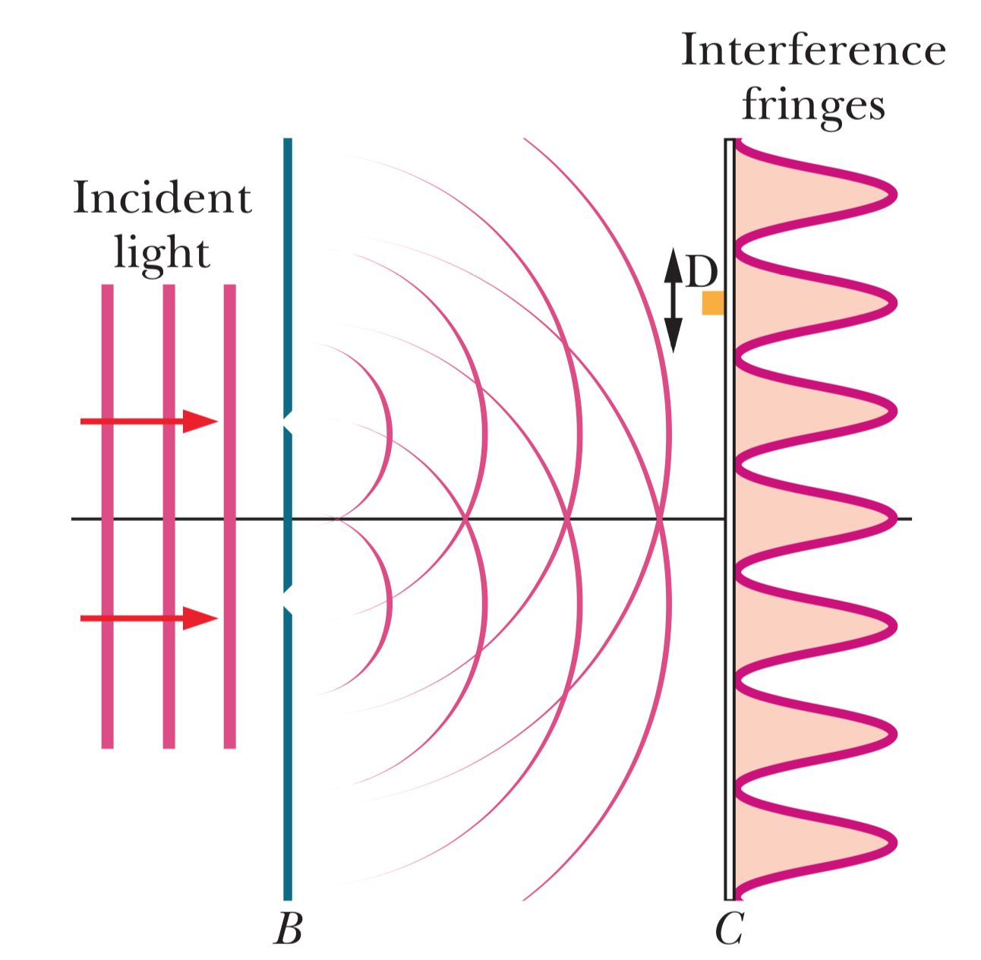
Double-slit experiment

Slide 2
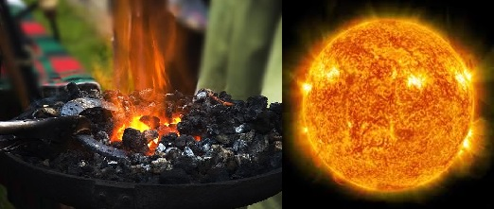
Thermal radiation
When heated, all objects emit electromagnetic radiation whose wavelength (and color) depends on the temperature of the object.

Slide 3
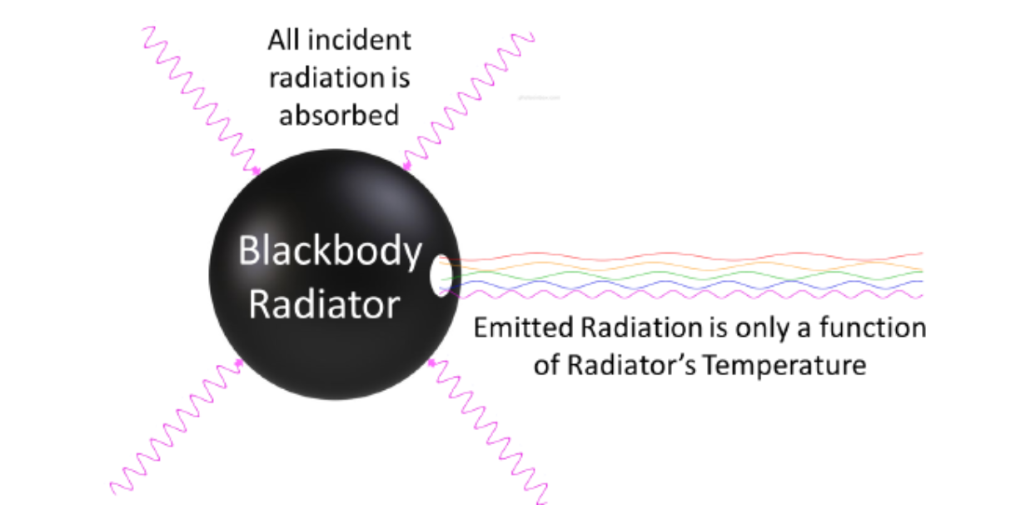
Ideal blackbody radiator

Slide 4
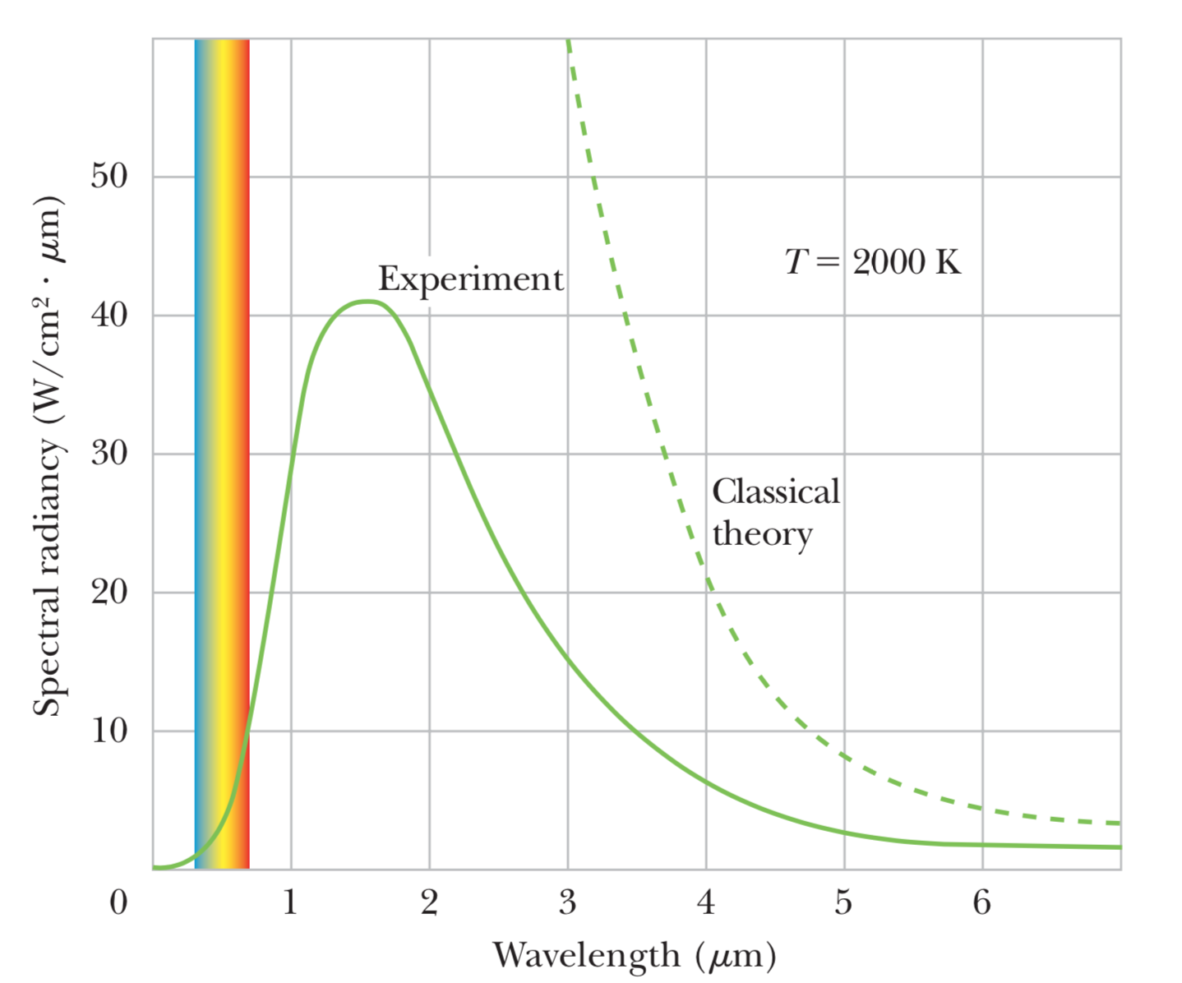
Spectral radiancy in blackbody experiment
Solid curve shows experimental spectral radiancy for cavity at 2000 K.

Slide 5
Double-slit experiment with electrons (1)
7 electrons

Slide 6
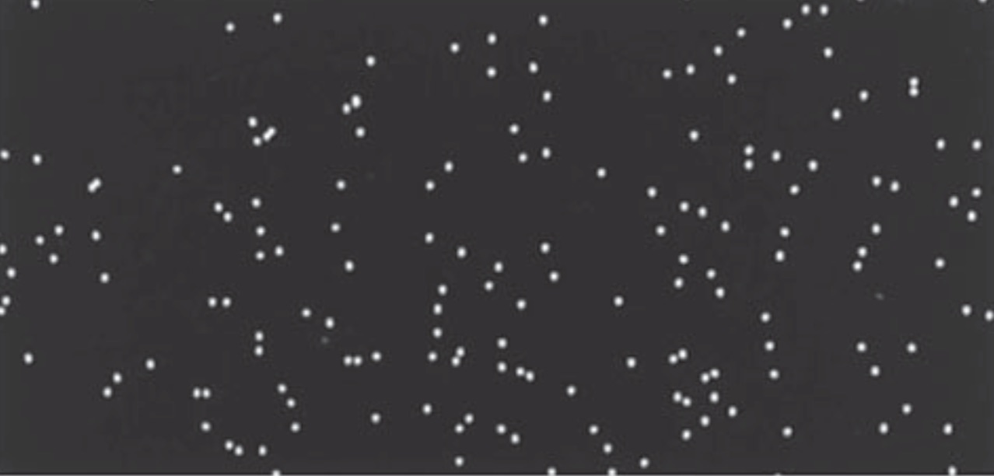
Double-slit experiment with electrons (2)
100 electrons

Slide 7
Double-slit experiment with electrons (3)
3,000 electrons

Slide 8
Double-slit experiment with electrons (4)
20,000 electrons

Slide 9
Double-slit experiment with electrons (5)
70,000 electrons

