Slide 1
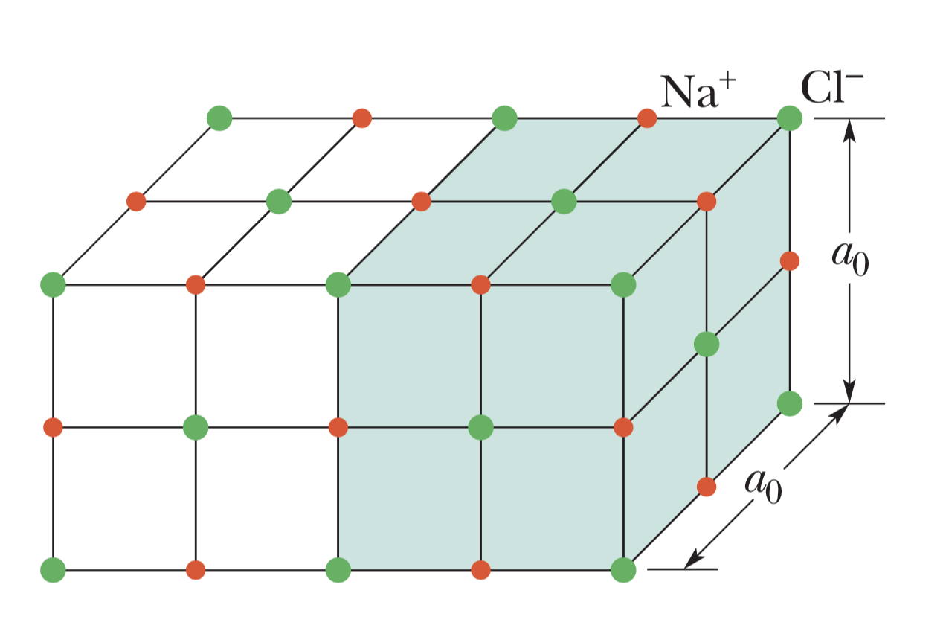
Crystalline solid

Slide 2
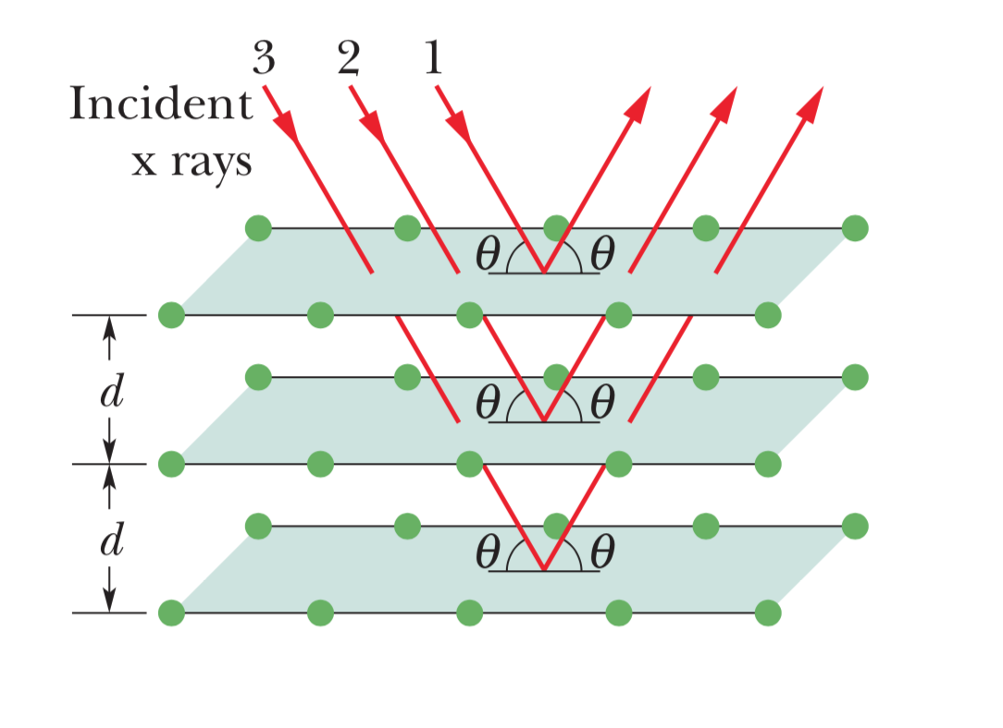
“Fictional planes” for analyzing intensity maxima

Slide 3
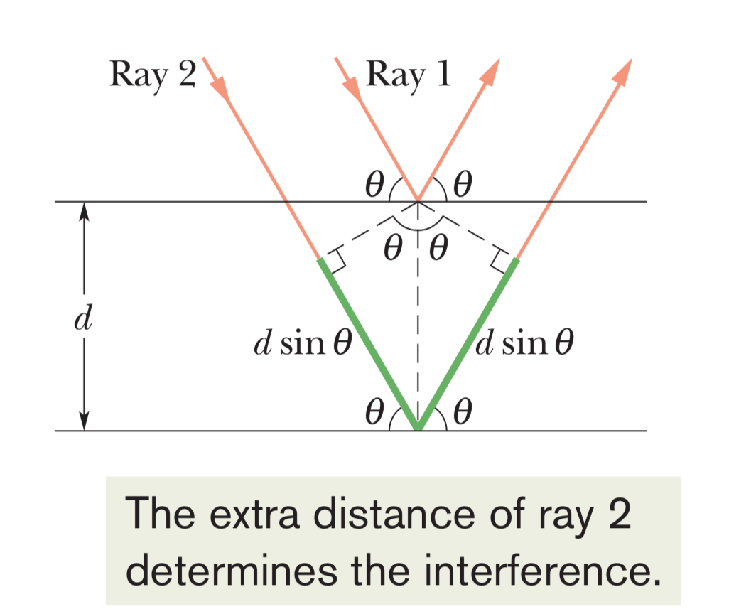
Analyzing path length differences

Slide 4
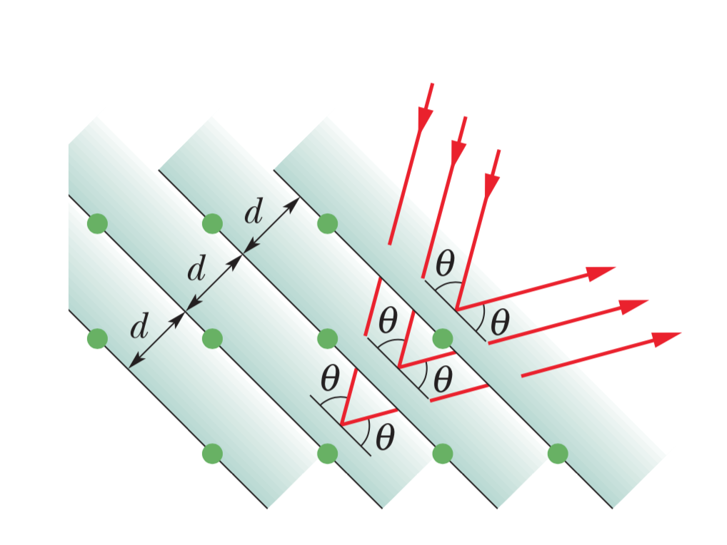
Different family of planes for analysis

