Slide 1
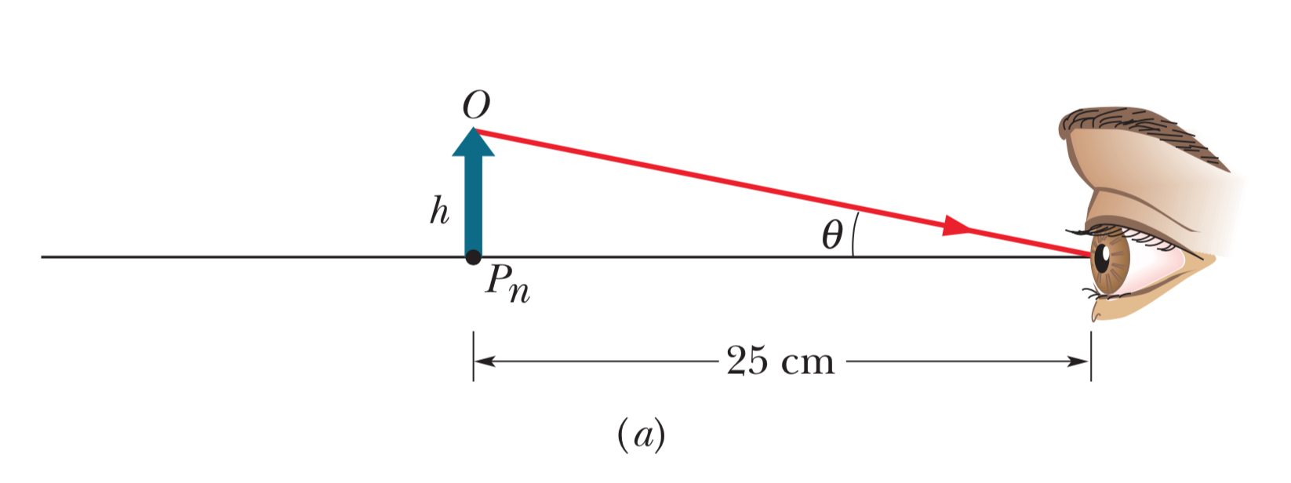
Object placed at eye’s near point
Image is not fuzzy since exactly at near point

Slide 2
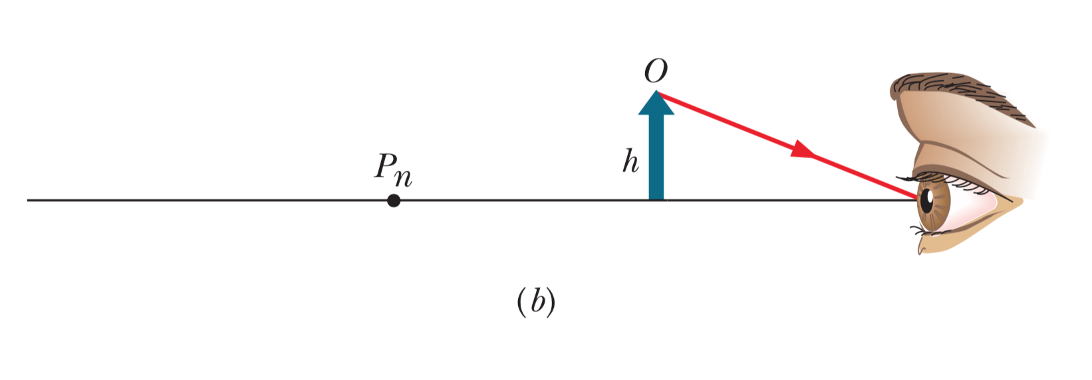
Object placed closer than near point
Object appears fuzzy

Slide 3
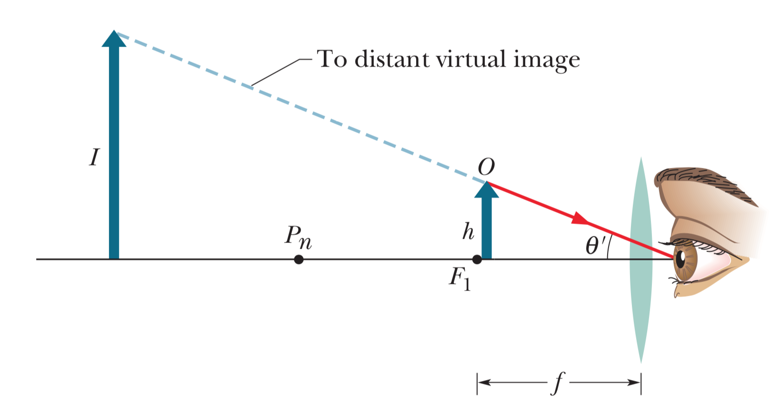
With converging lens, virtual image created
With glasses, eye perceives virtual image larger and past near point (so not fuzzy)

Slide 4
Nearsightedness (myopia)
Object is past far point of the eye, so image formed in front of retina and appears fuzzy

Slide 5
Correcting nearsightedness
Diverging lens forms image on retina

Slide 6
Correcting nearsightedness
Diverging lens generates virtual image formed at far point

Slide 7
Farsightedness (hyperopia)
Object closer than near point of eye, image formed behind retina and thus fuzzy

Slide 8
Correcting farsightedness
Converging lens forms image on retina

Slide 9
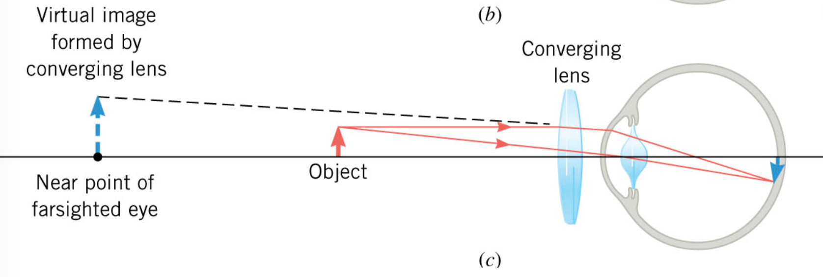
Correcting farsightedness
Converging lens generates virtual image at near point

Slide 10
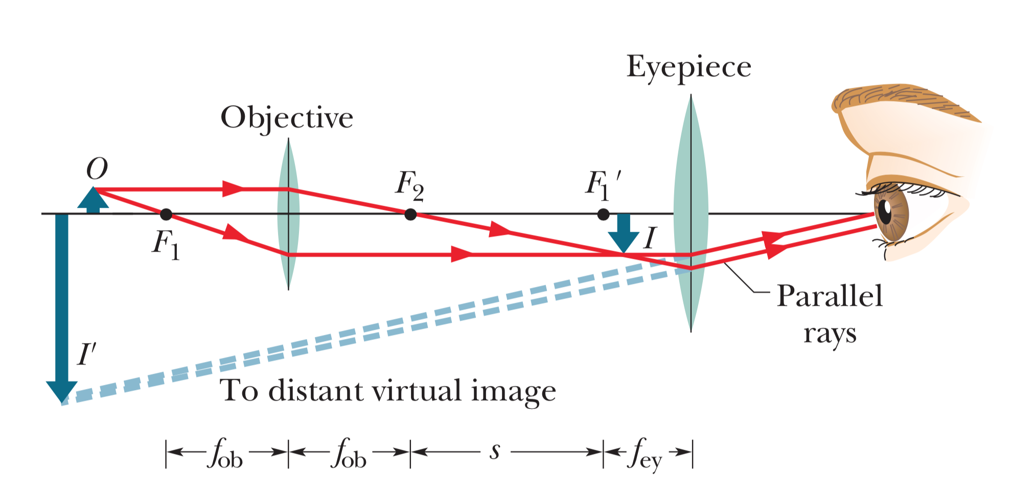
Compound microscope

Slide 11
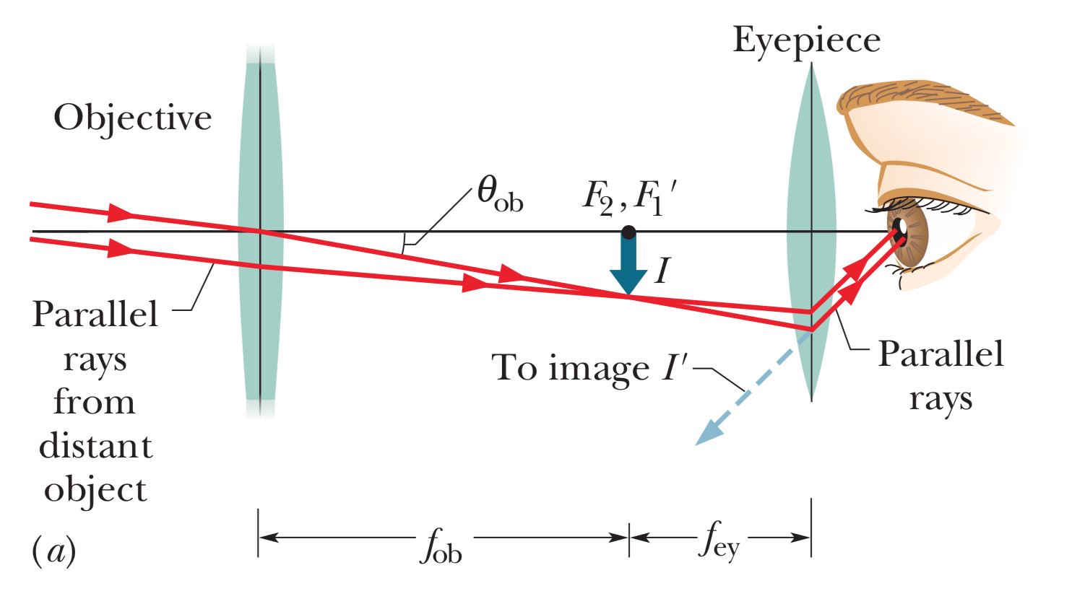
Telescope

Slide 12
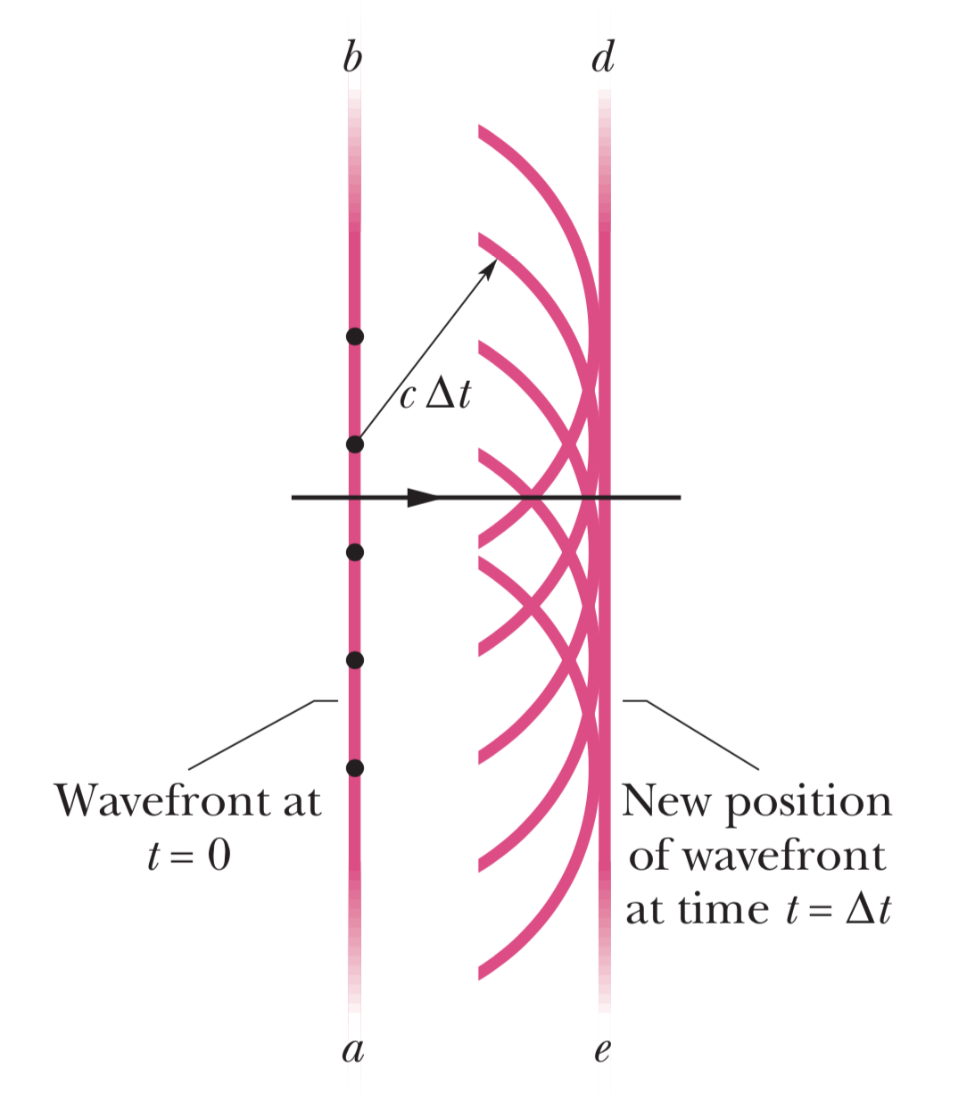
Huygens’ principle for plane waves
Plane wave at ab
Points on wavefront propagate as secondary spherical wavelets
After time ∆t, radius of wavelets grows to c∆t
Plane de tangent to wavelets and represents new wavefront

Slide 13
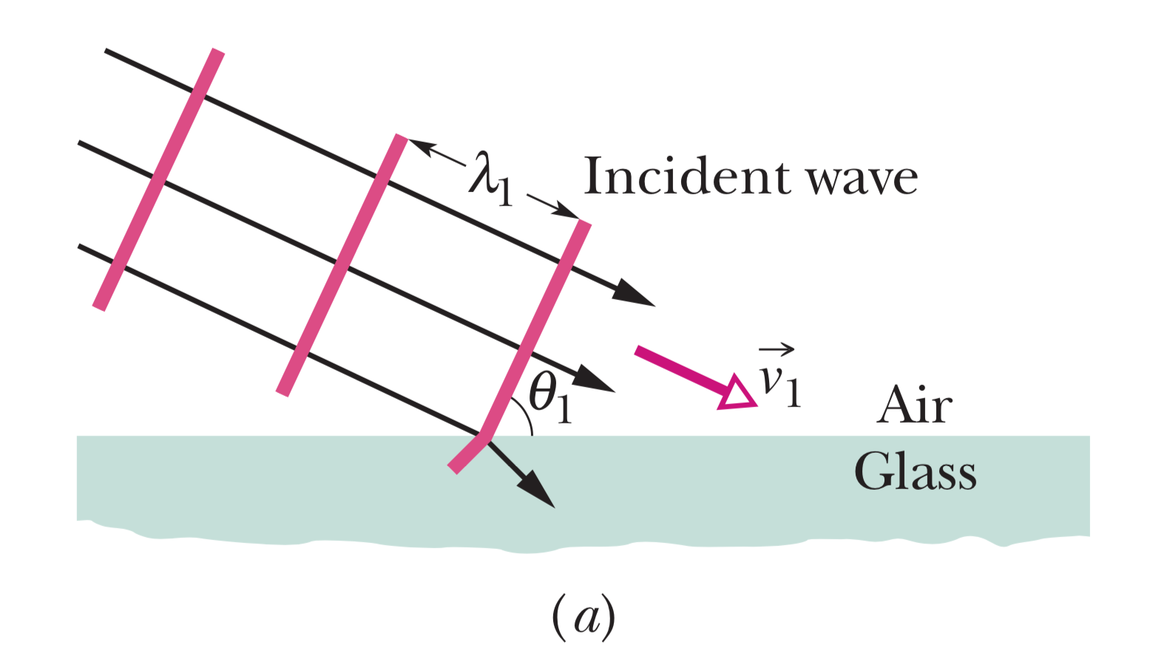
Deriving Law of Refraction from Huygens’ Principle
Plane waves are incident on surface

Slide 14
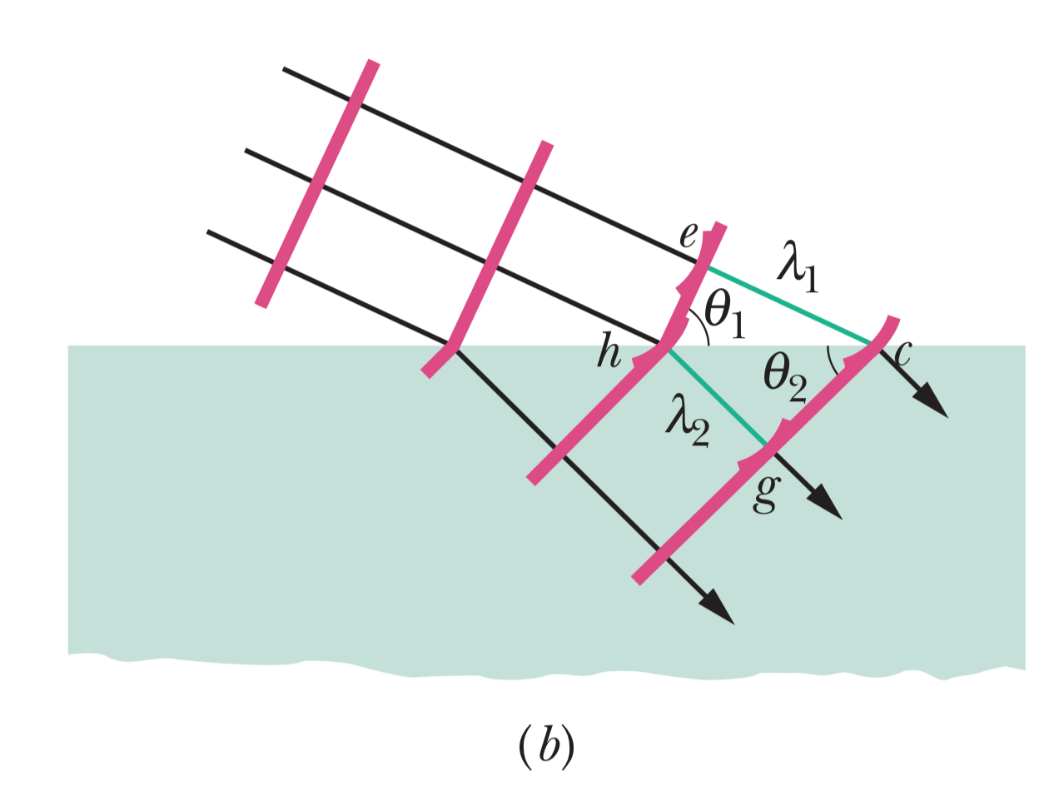
Deriving Law of Refraction from Huygens (2)
New plane waves are tangent to spherical surfaces
Use geometry to figure out angles

Slide 15
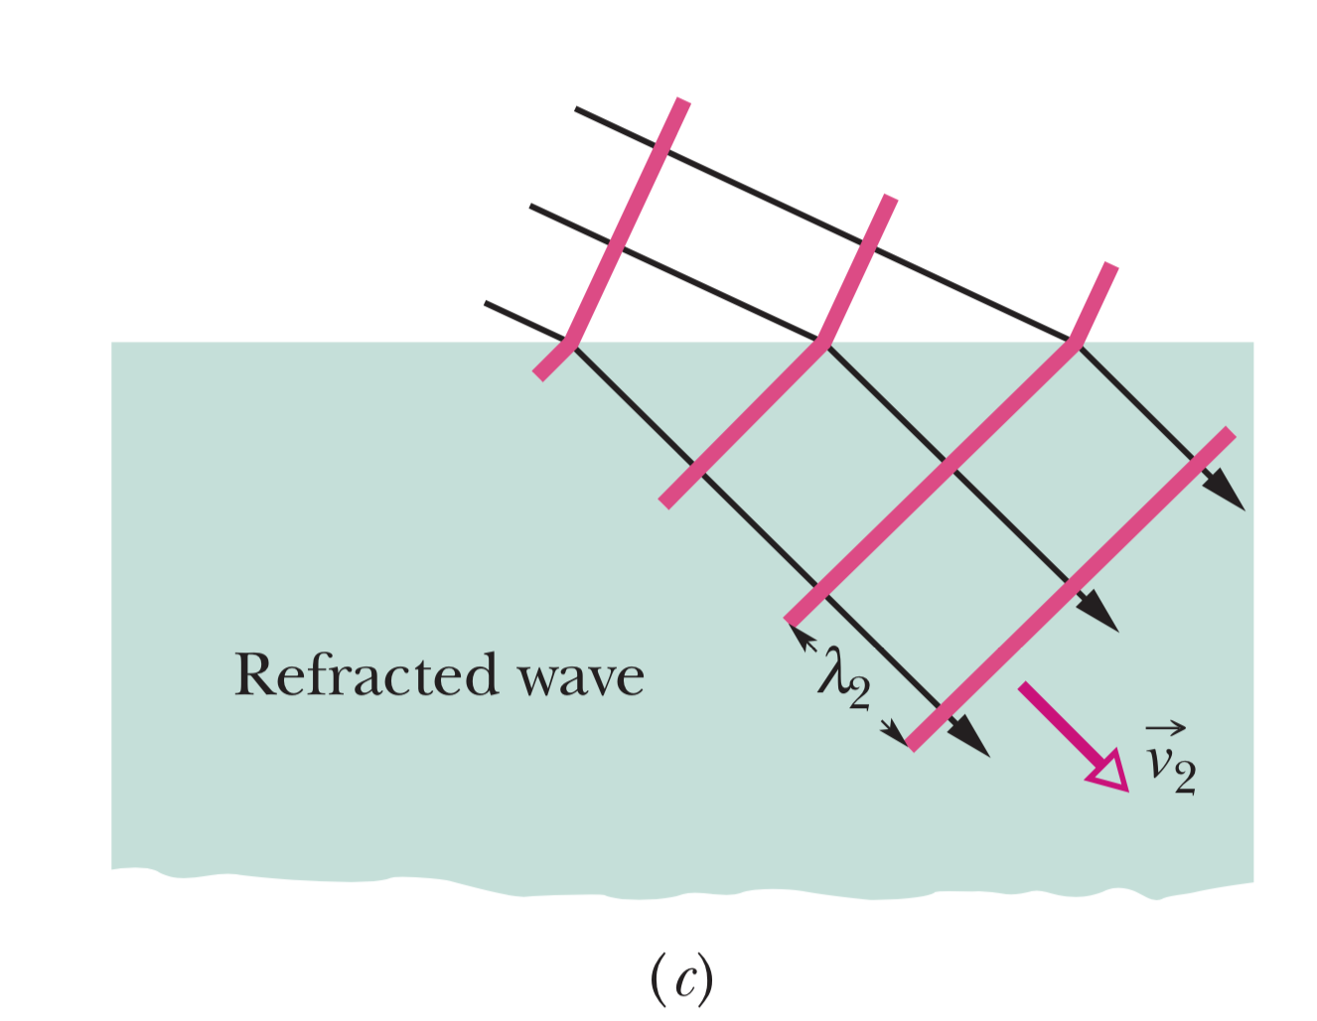
Deriving Law of Refraction from Huygens (3)
We can then see new direction of plane waves

