Slide 1
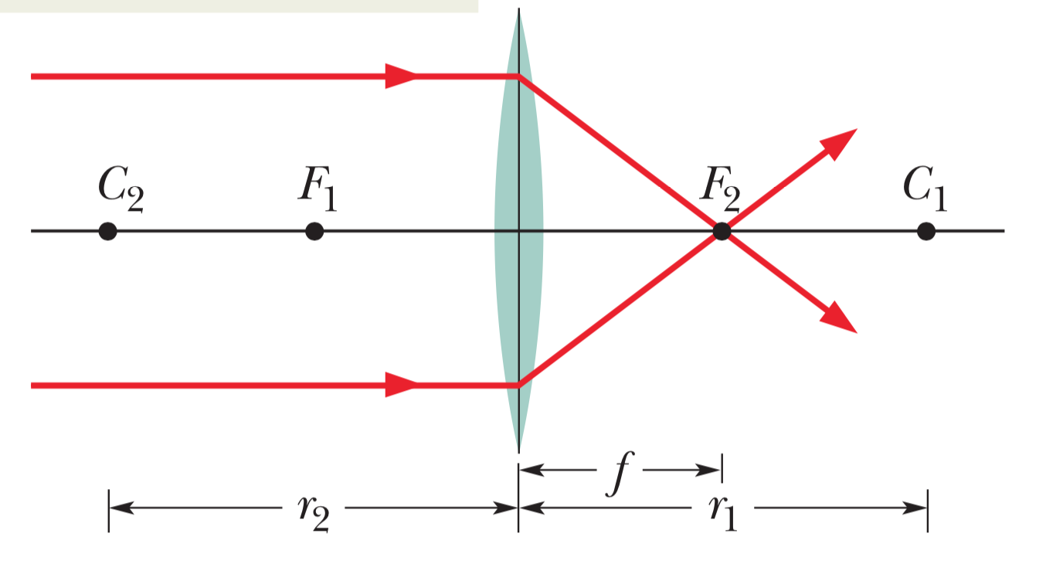
Converging Lens
Converging lens causes parallel light rays to converge at a real focal point F₂. (Notice other focal point)

Slide 2
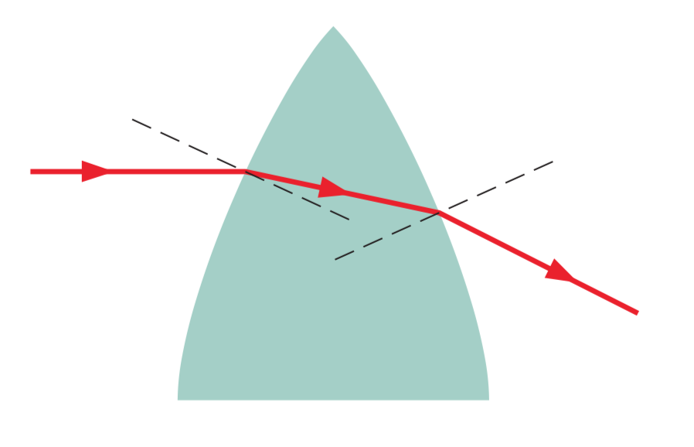
Converging Lens - Bending
Bending occurs only at the surfaces

Slide 3
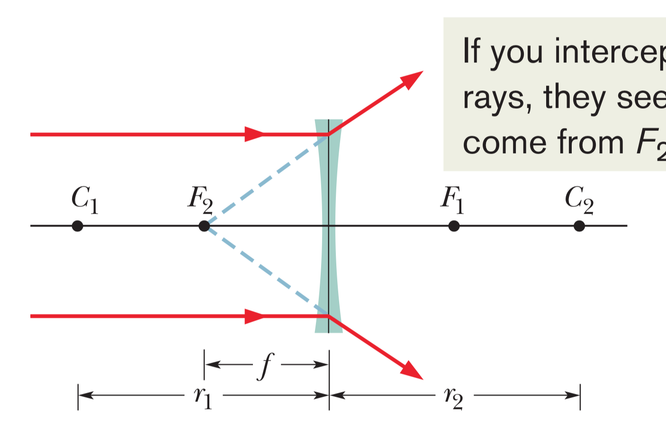
Diverging Lens
Diverging lens causes parallel light rays to diverge. Thus only a virtual focal point F₂. (Notice other focal point)

Slide 4
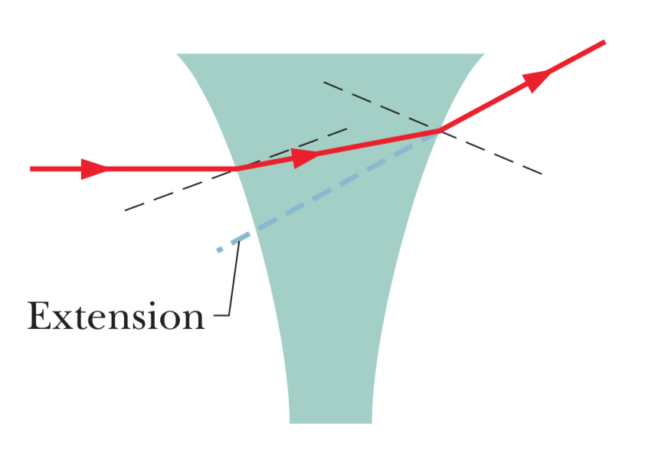
Diverging Lens - Bending
Bending occurs only at the surfaces

Slide 5
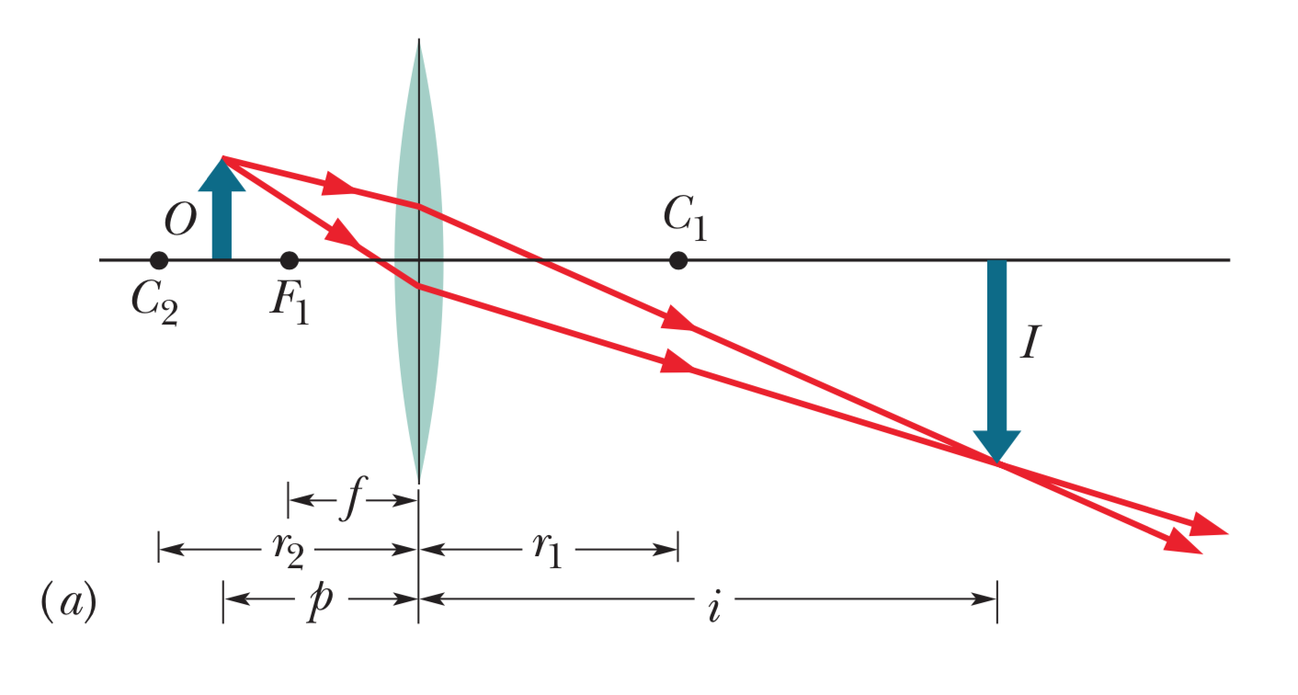
Images from converging lenses (1)
Object outside the focal point F₁

Slide 6
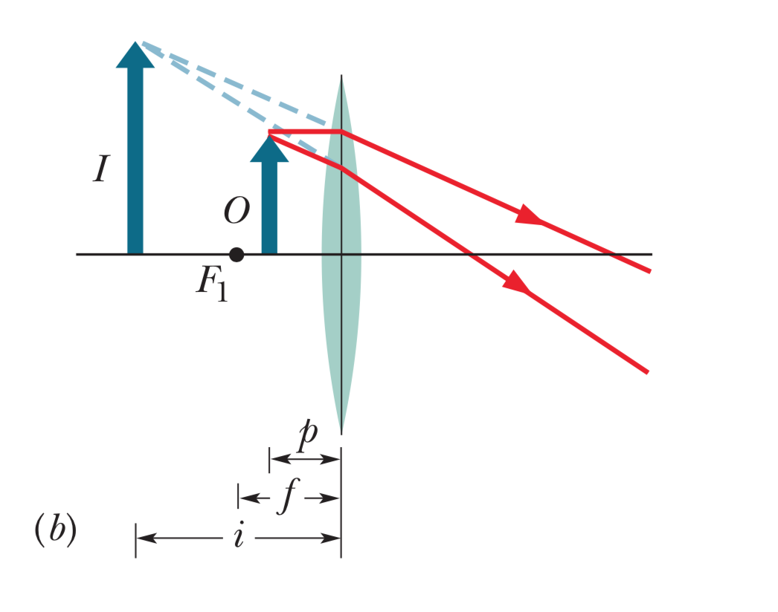
Images from converging lenses (2)
Object inside the focal point F₁

Slide 7
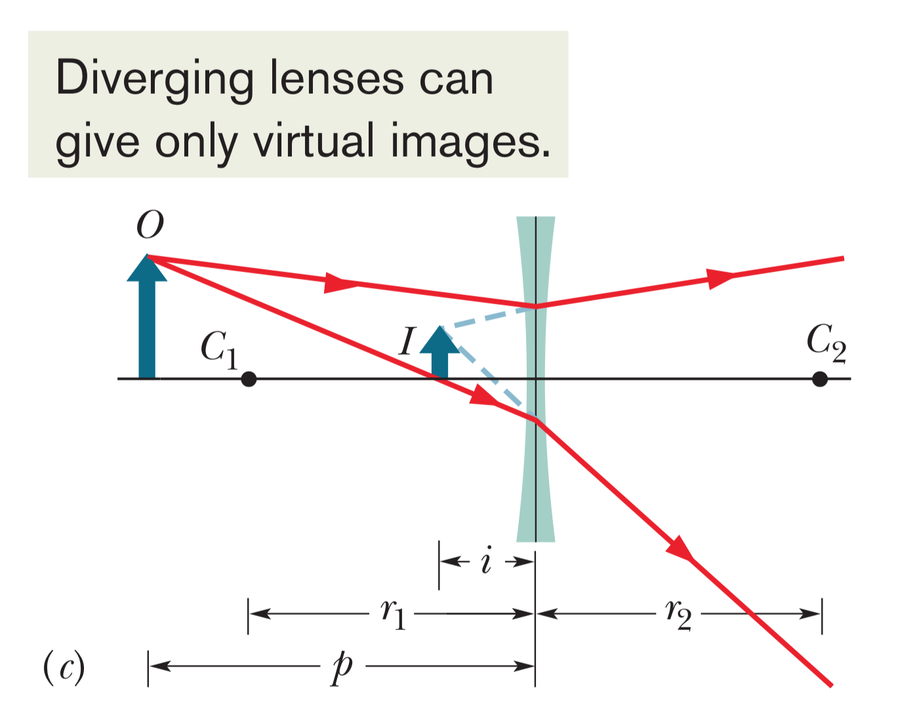
Images from diverging lenses

Slide 8
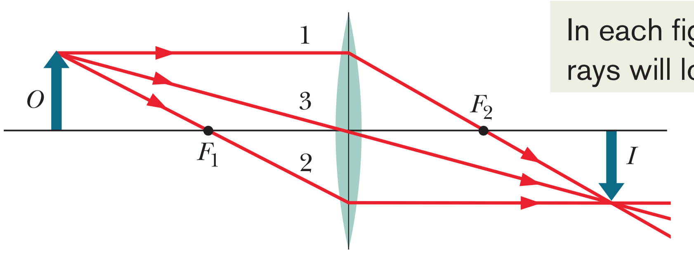
Locating an image (converging lens 1)

Slide 9
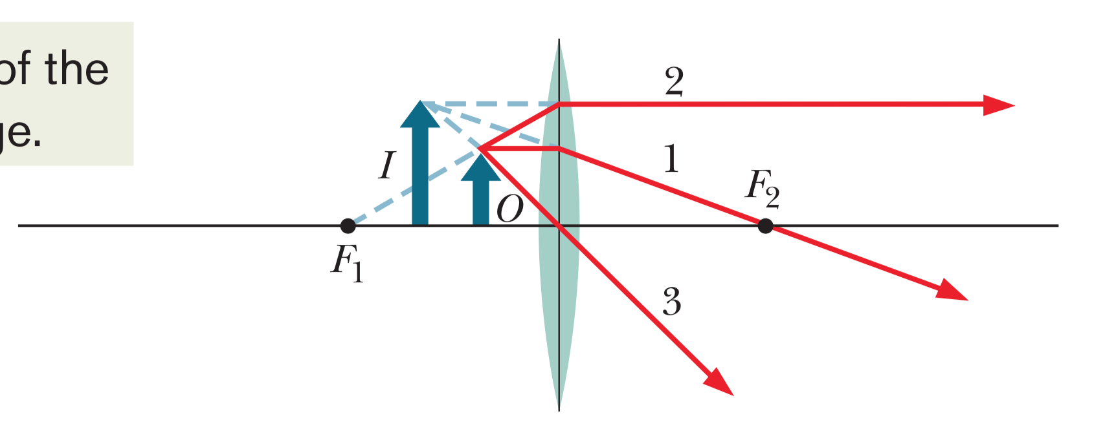
Locating an image (converging lens 2)

Slide 10
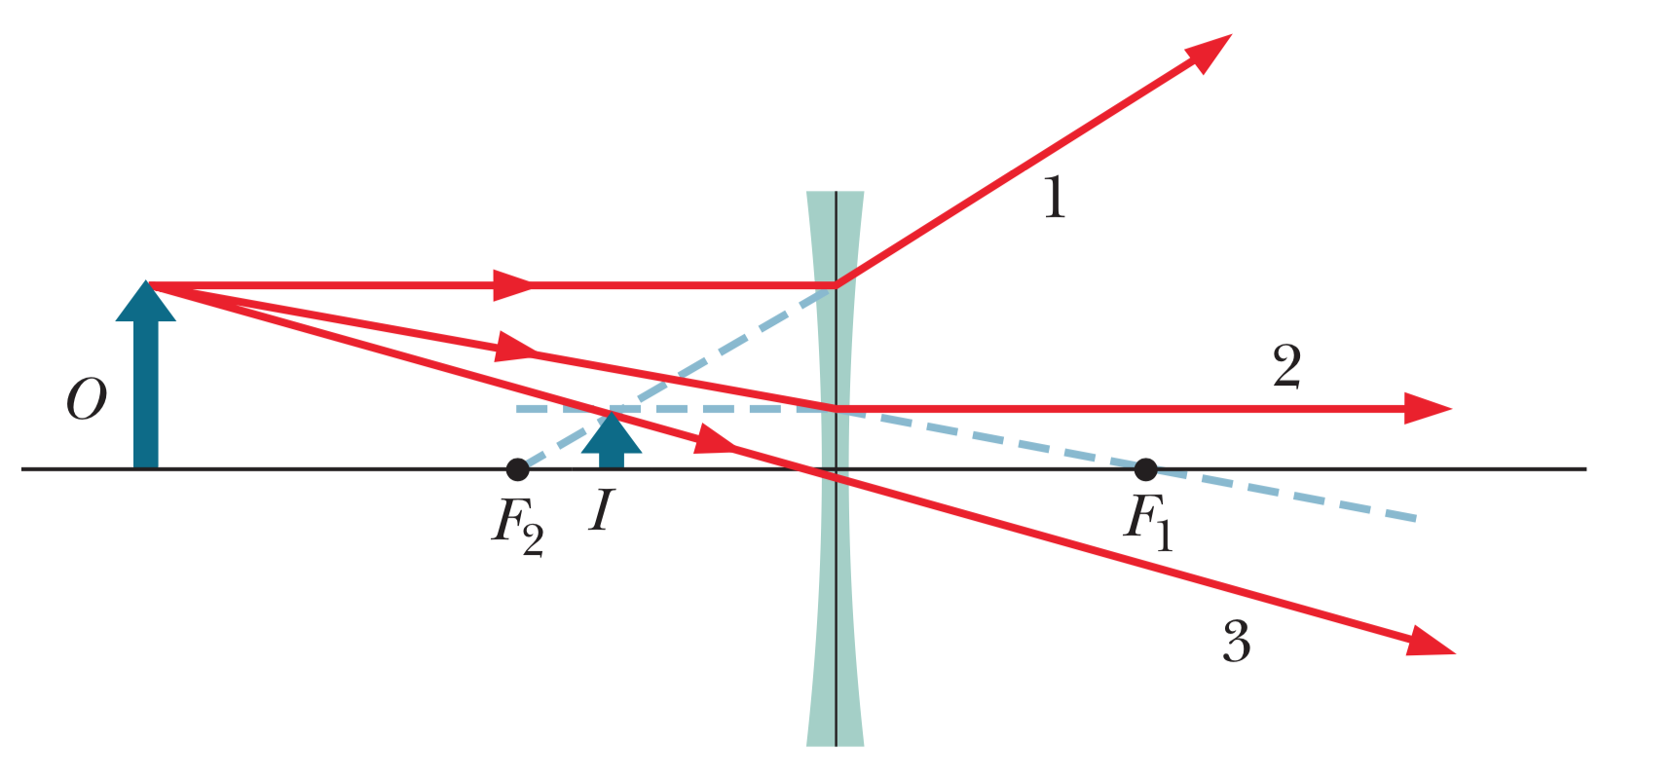
Locating an image (diverging lens)

Slide 11
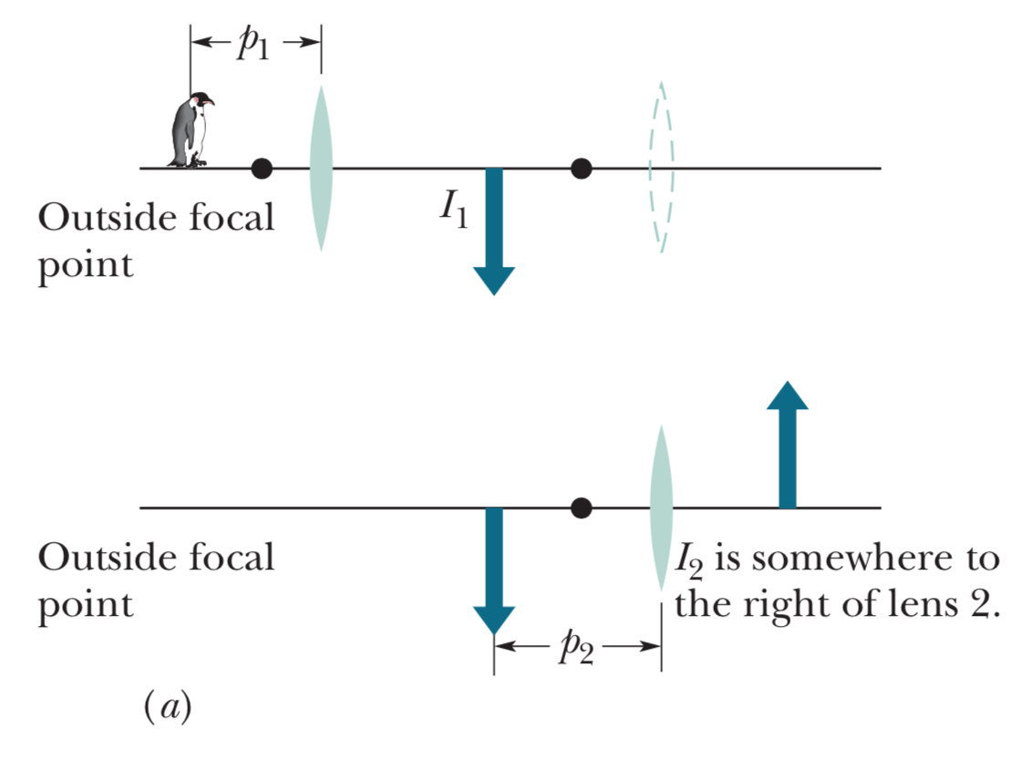
Two-lens systems (1)

Slide 12
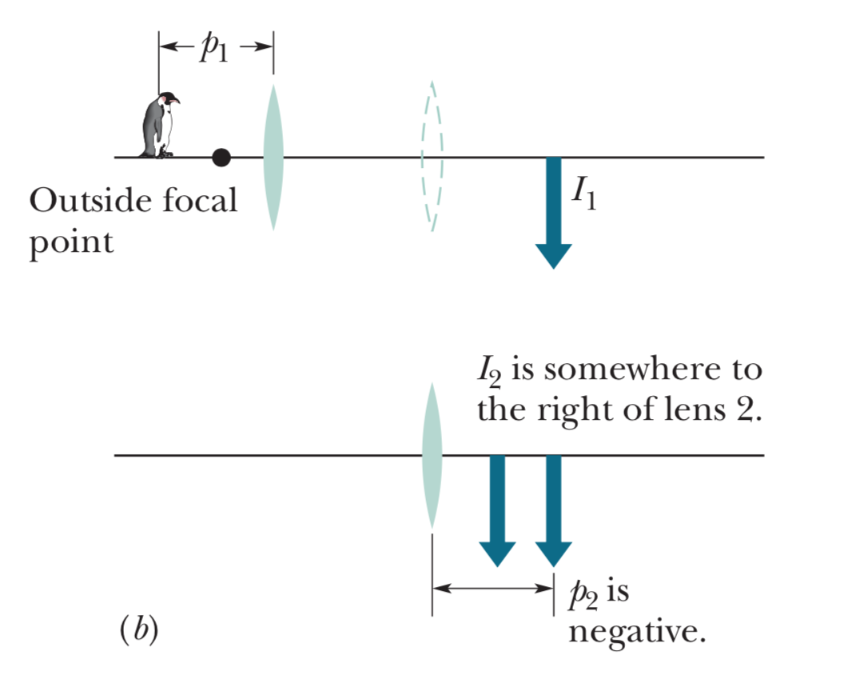
Two-lens systems (2)

Slide 13
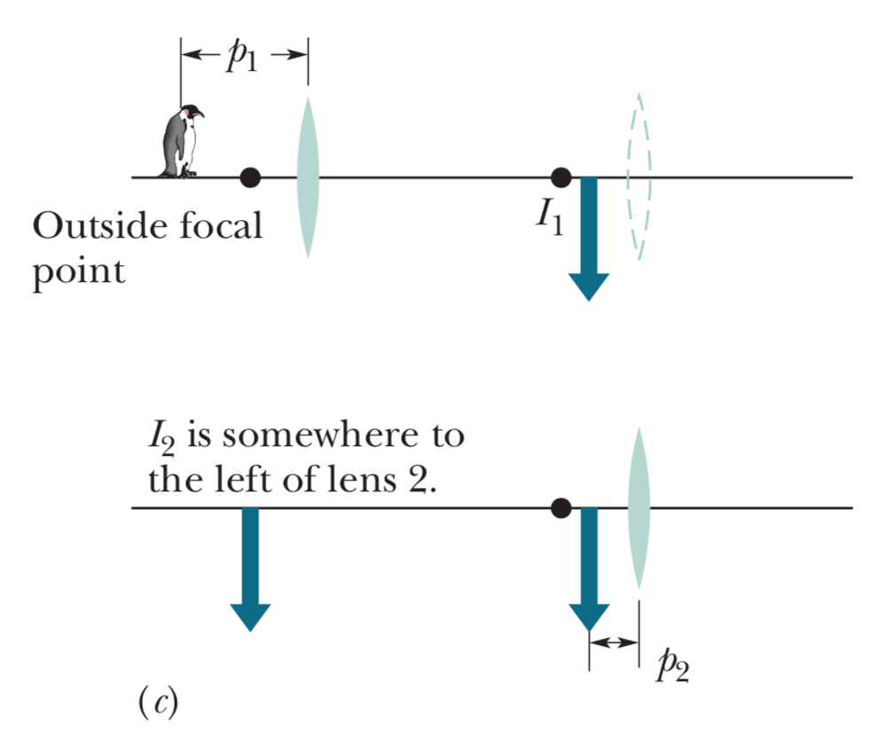
Two-lens systems (3)

Slide 14
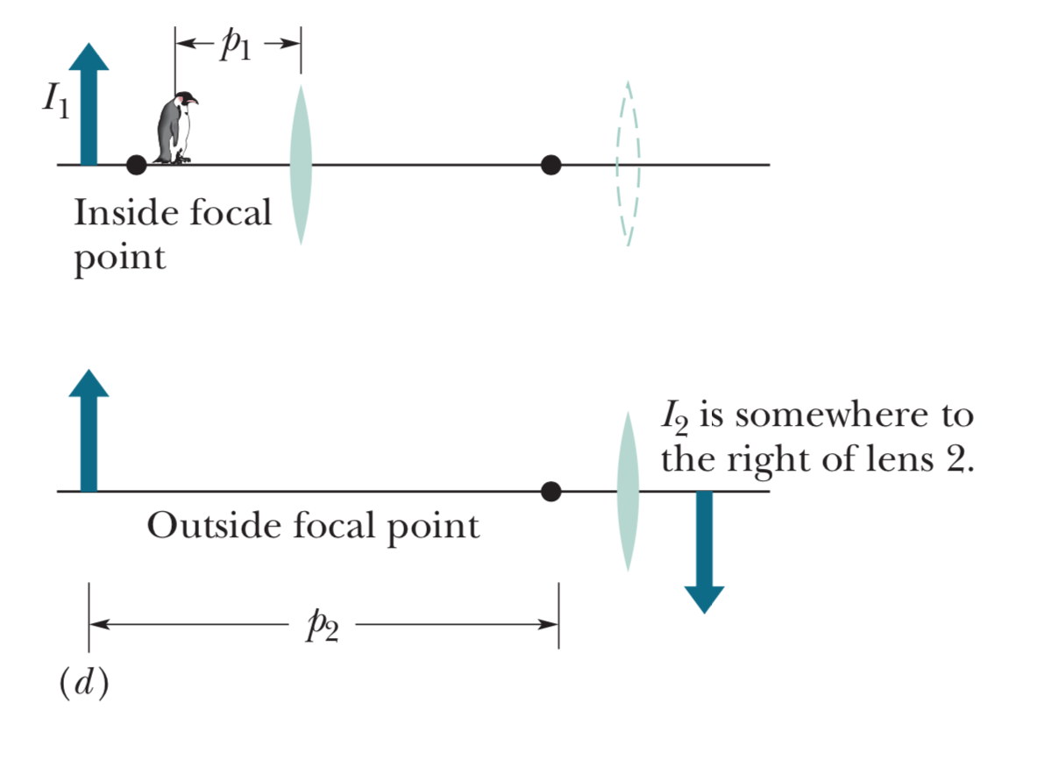
Two-lens systems (4)

Slide 15
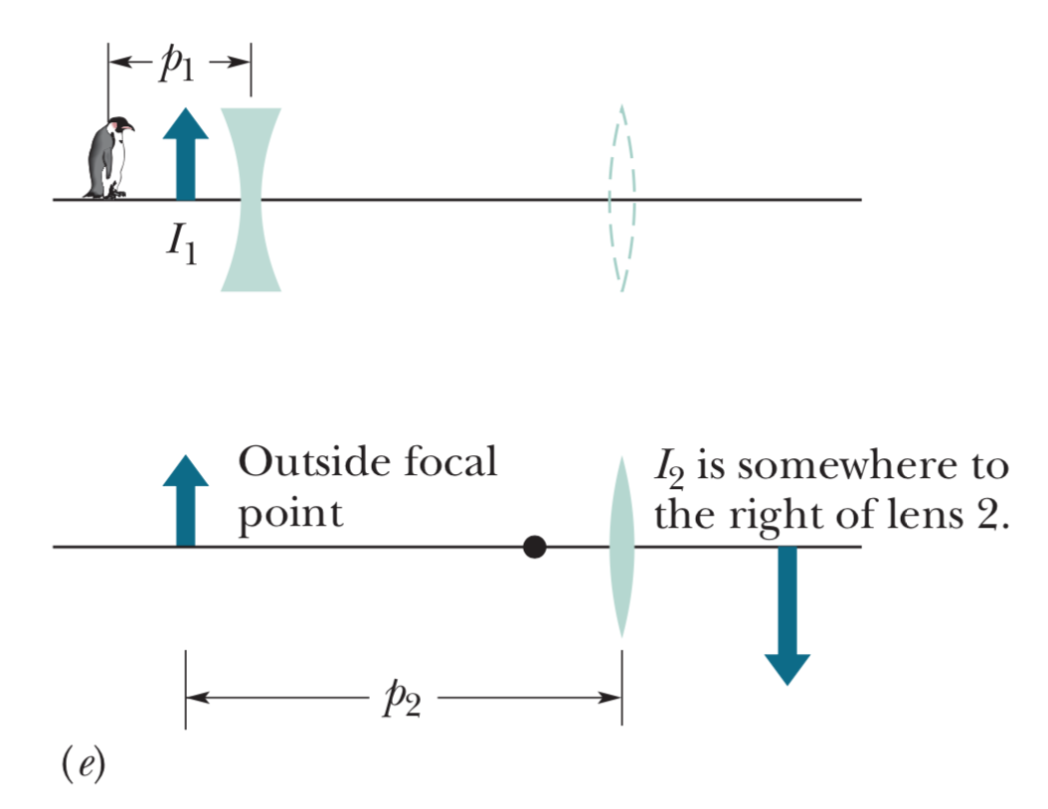
Two-lens systems (5)

Slide 16
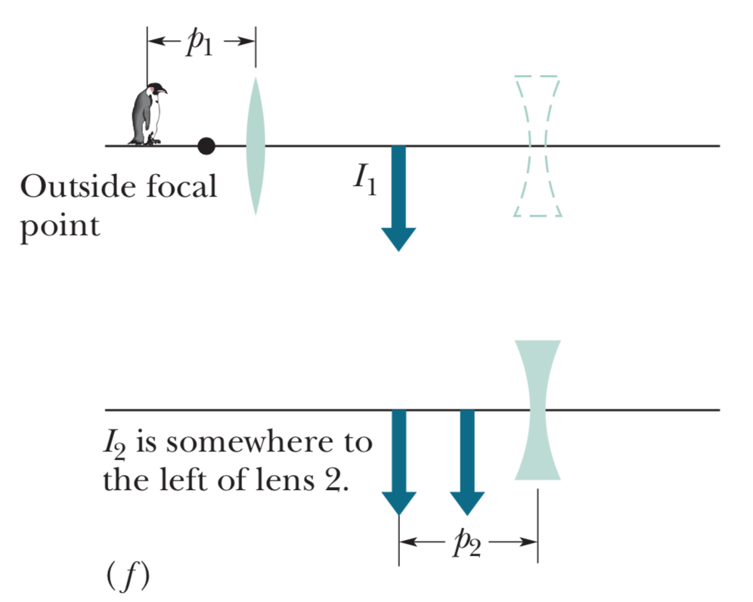
Two-lens systems (6)

